Slide 1
SuPplement sales prediction

Slide 2
Approach - i
Model selection
Data exploration and cleaning
Feature engineering
Data visualisation
Data preparation

Slide 3
Approach - ii
Feature encoding
Training the model
Predicting sales
Model evaluation
Residual analysis

Slide 4
Model selection
We decided to go ahead with linear regression due to its ease of interpretability.
Another factor was that we needed to predict a numerical variable.
Linear regression helped us to determine the features that were more important for prediction.

Slide 5
Data exploration and cleaning
There weren’t really any interesting insights obtained in terms of statistics during the data exploration phase.
The data was already clean (no null values or outliers).
We only removed the ‘ID’ and ‘#Order’ columns from the train set and the ‘ID’ column from the test set.

Slide 6
Feature engineering
We extracted the year and month of the date at which a sale was made.
However, we had to drop these features post visualisation as they didn’t really help in predicting sales.

Slide 7
Data visualisation - i
We visualised two factors separately against multiple features –
Number of sales
Amount of sales

Slide 8
Data visualisation - ii
The maximum number of sales is observed
In store type S1
In location type L1
For region code R1
On a non-holiday
Without giving a discount
In 2018
In the first five months

Slide 9
Data visualisation - iii
The amount of sales
Generally lies in the range 30,000 – 40,000
Is the highest for store type S4
Is the highest for location type L2
Is not really affected by the generated features of year and month

Slide 10
Data preparation
We dropped the following columns from the train set:
Store_id
Date
Year
Month
We dropped the following columns from the test set:
Store_id
Date

Slide 11
Feature encoding
We encoded the following features in the train and test set:
Store_Type
Location_Type
Region_Code
Discount

Slide 12
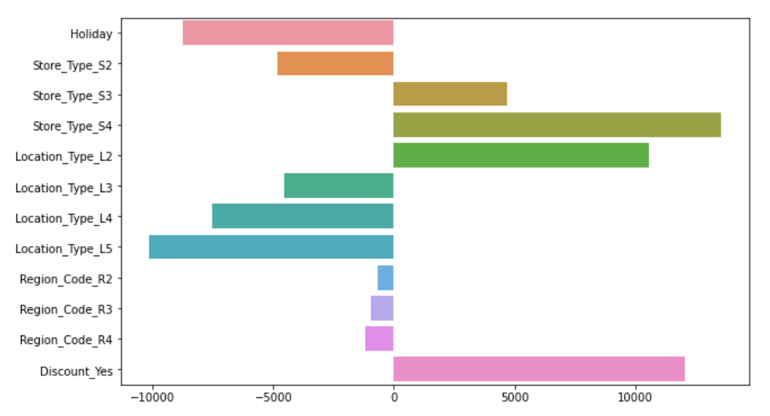
Training the model

Slide 13
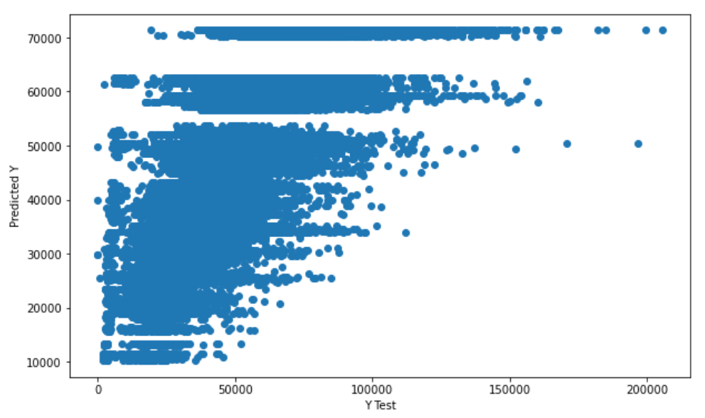
Predicting sales

Slide 14
Model evaluation
Mean absolute error: ~8,500
Root mean squared error: ~12,000
R-squared: ~55%
Note: The prediction and evaluation have been done on a 70-30 split of the given train set.

Slide 15
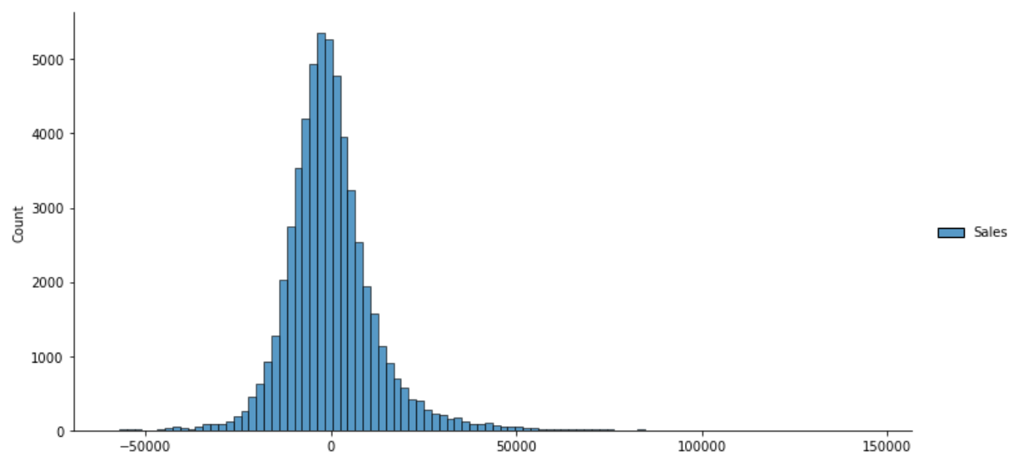
Residual analysis

Slide 16
Thank you!

